Slide 1
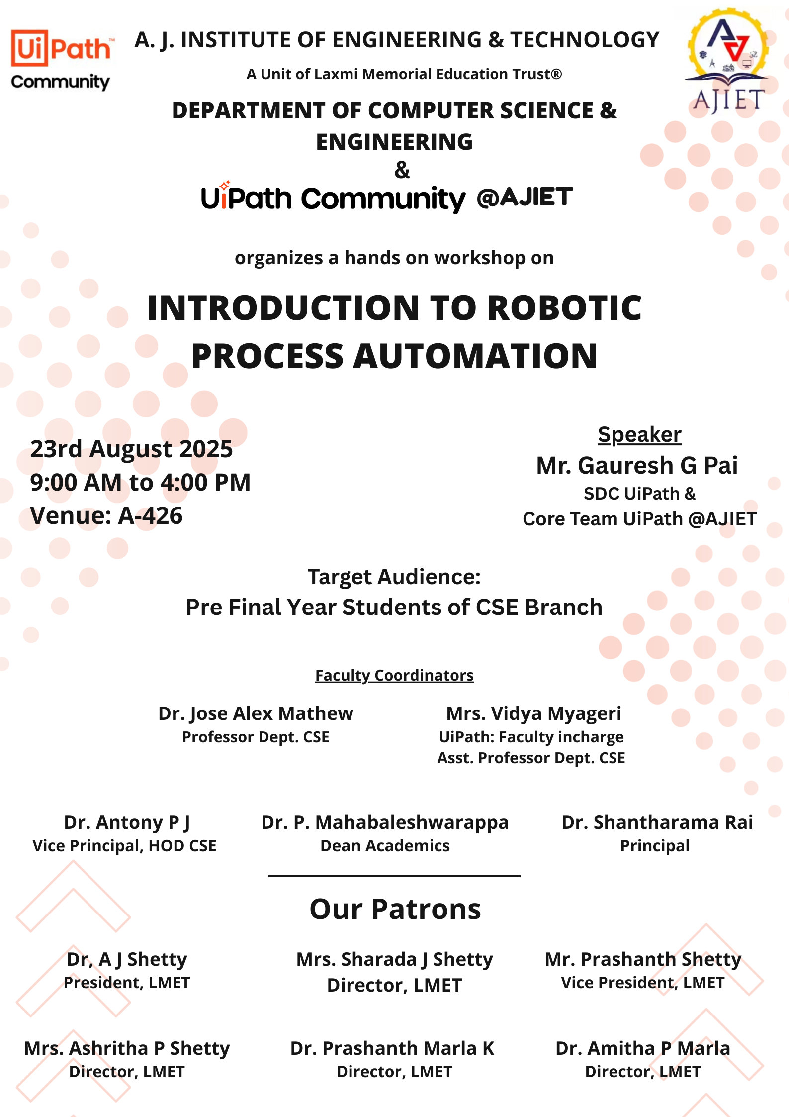

Slide 2
INTRODUCTION
TO
ROBOTIC
PROCESS
AUTOMATION

Slide 3





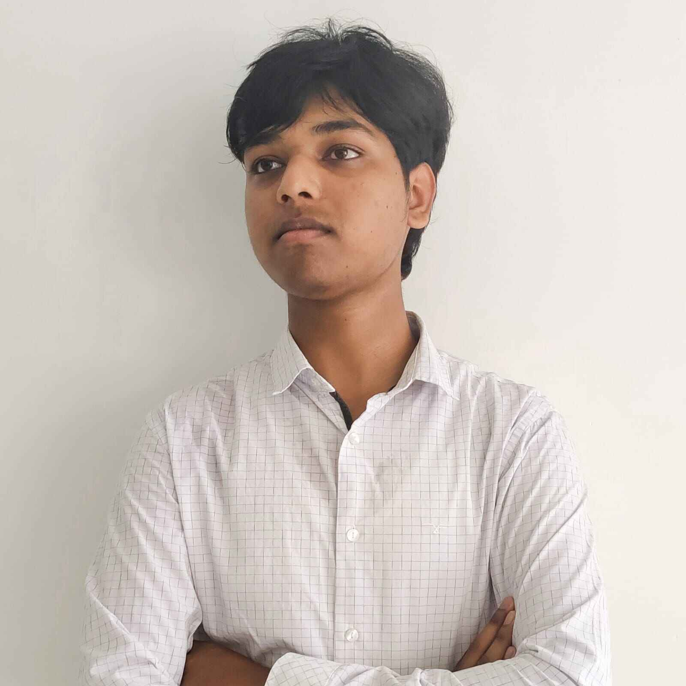
Core Team UiPath @AJIET

Slide 4

What You Can Expect Today?

Slide 5
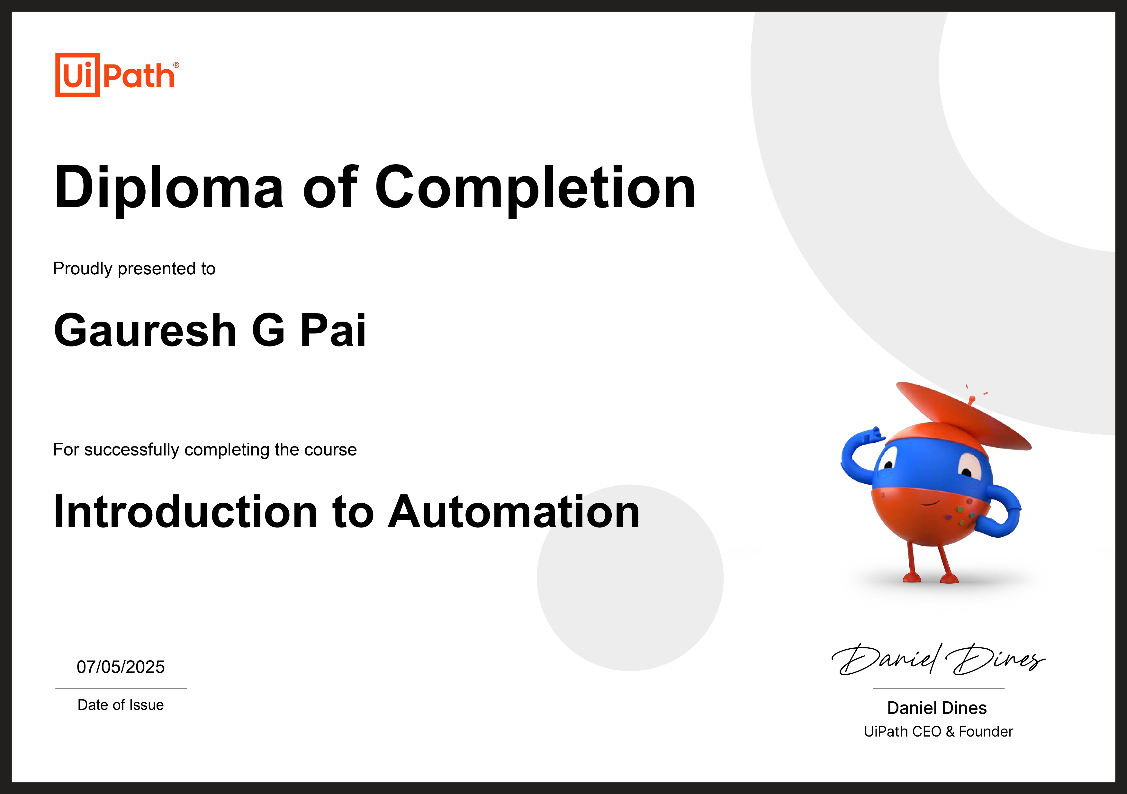
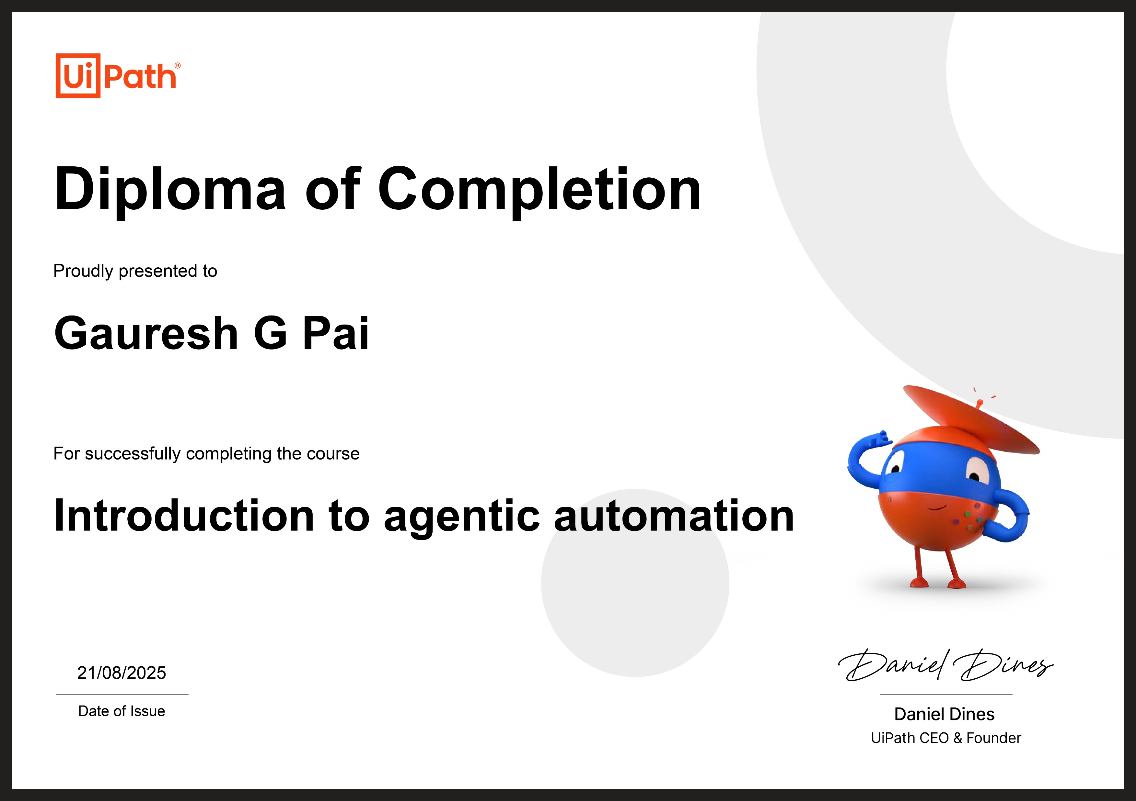

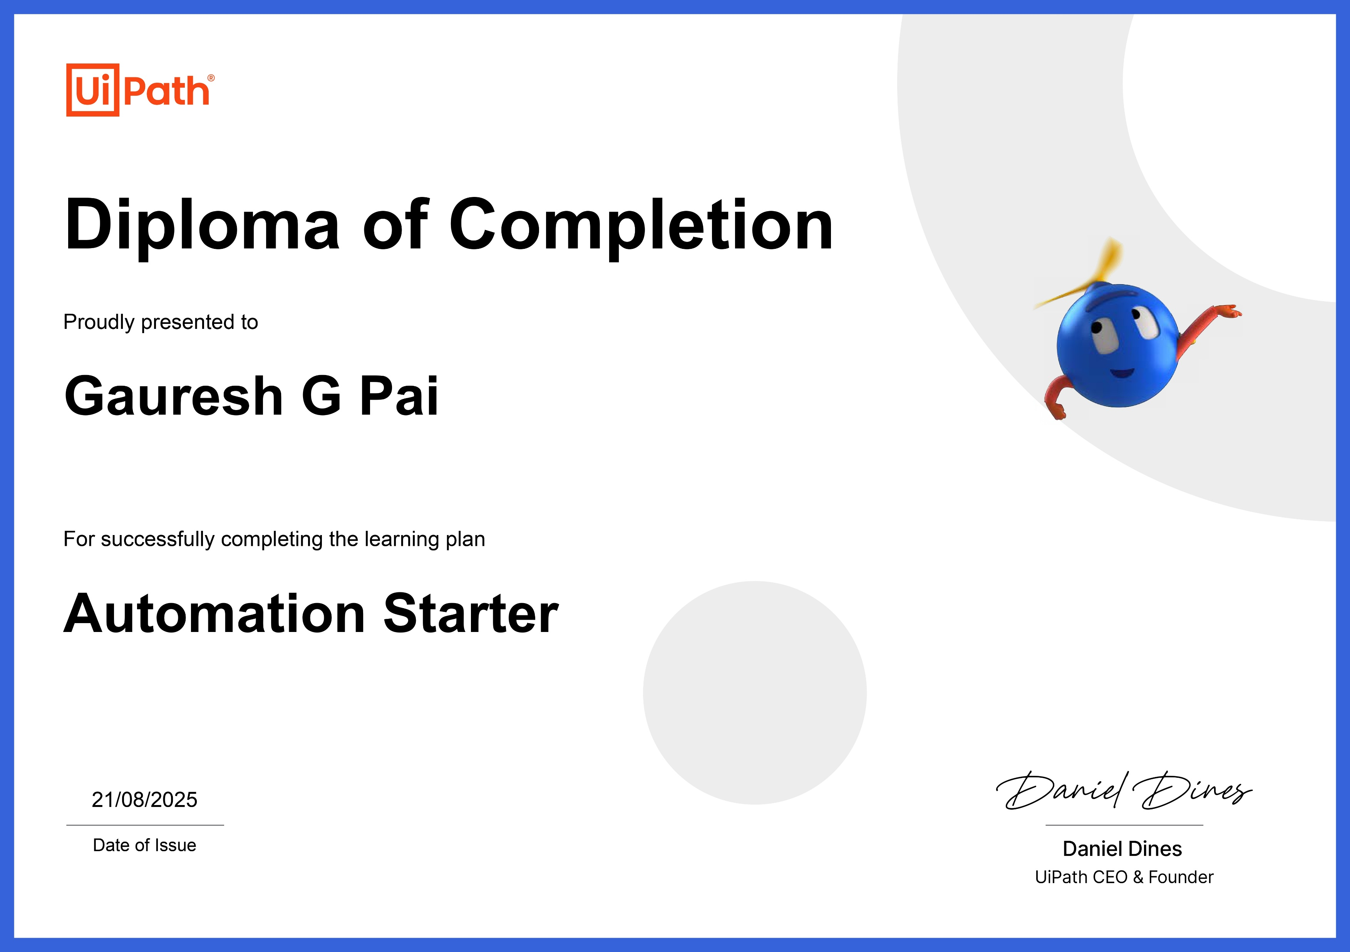
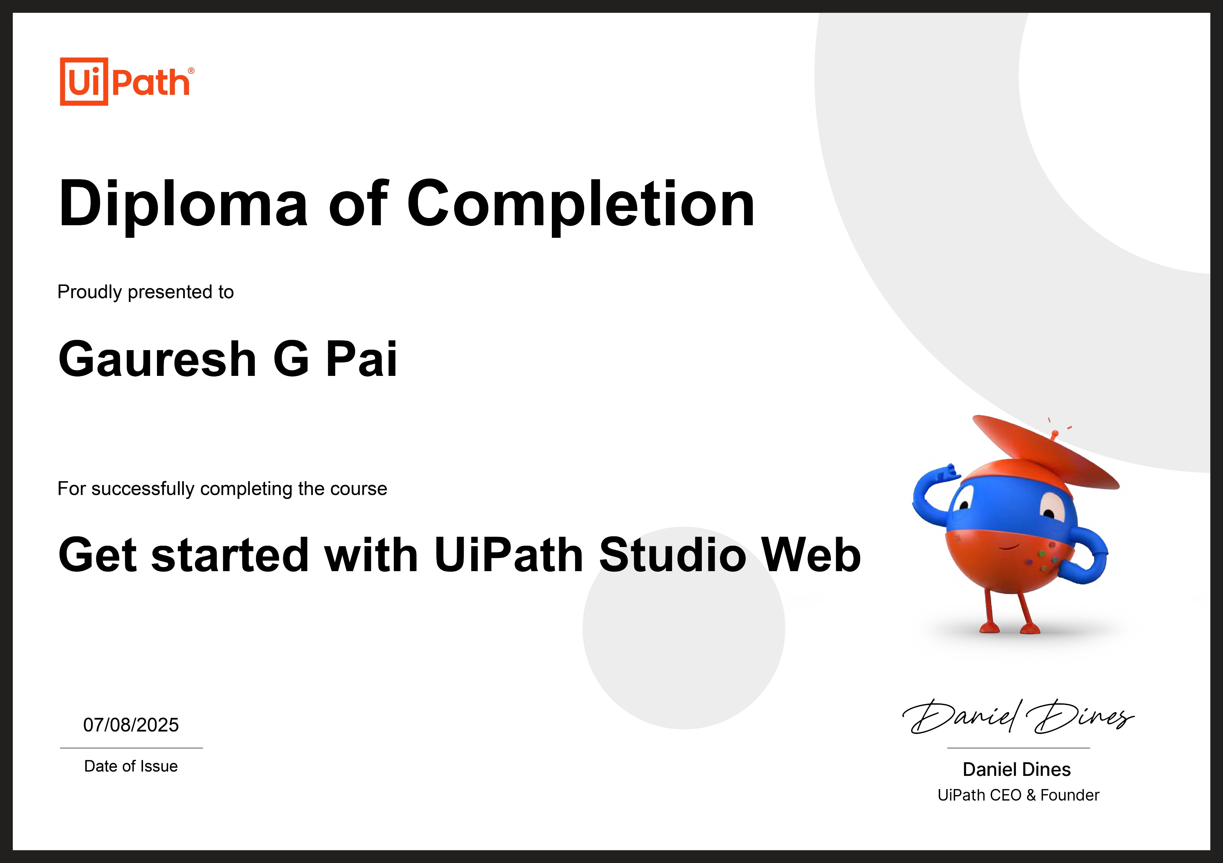
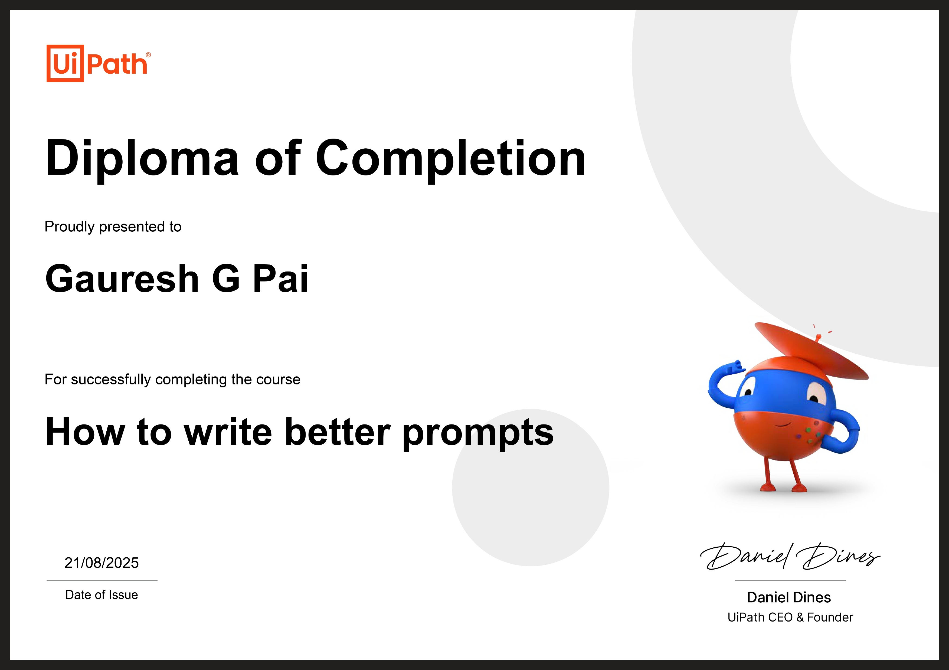

Slide 6
What are you going to do today?

Slide 7
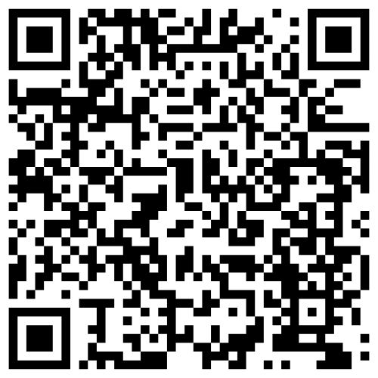
https://academy.uipath.com/learning-plans/rpa-starter

Slide 8
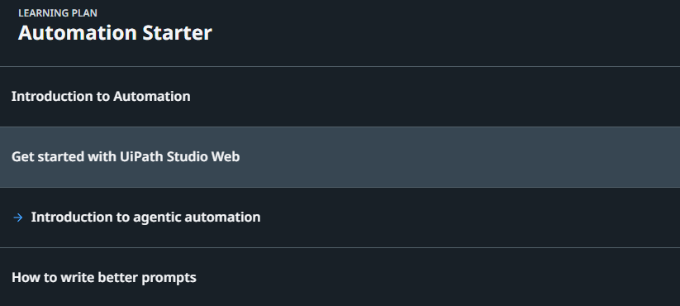
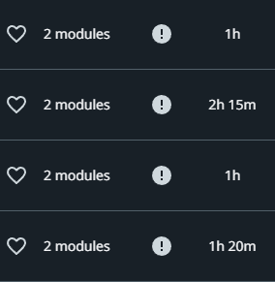

Slide 9
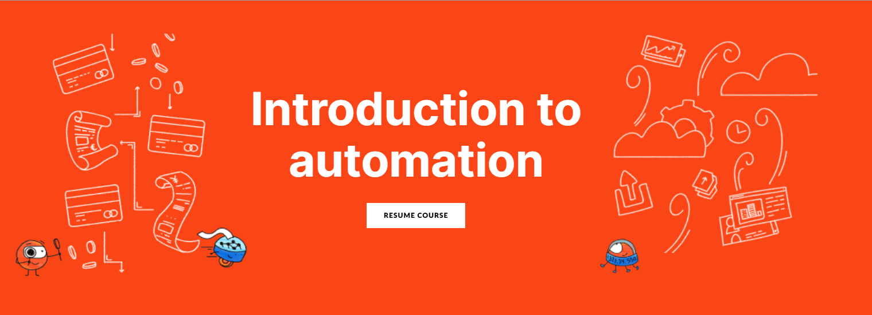

Slide 10


Slide 11
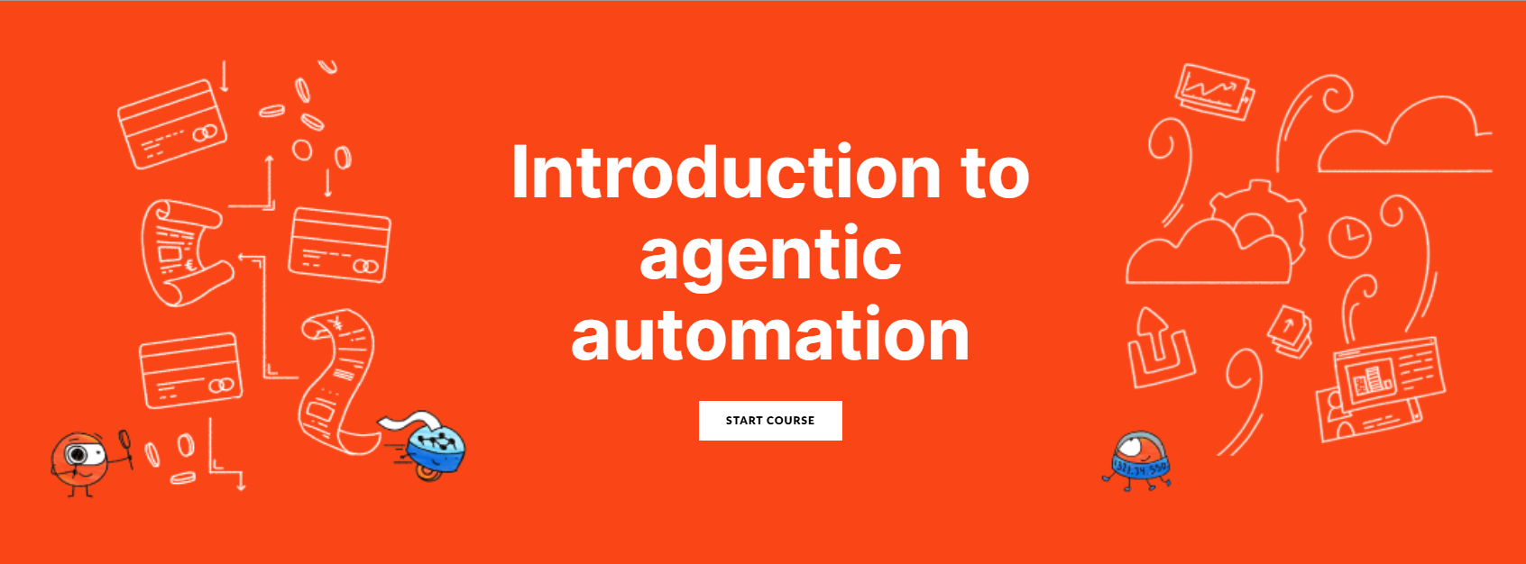

Slide 12
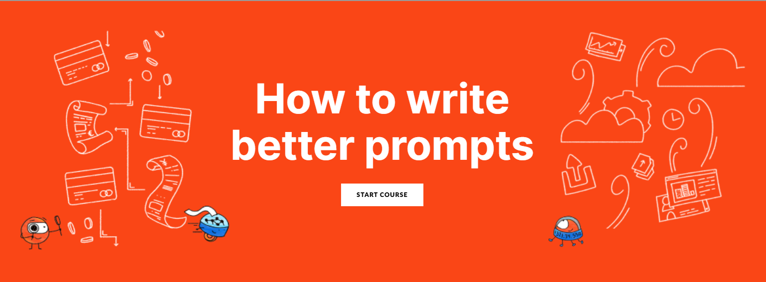

Slide 13
Let’s dive deep into Automation!

Slide 14
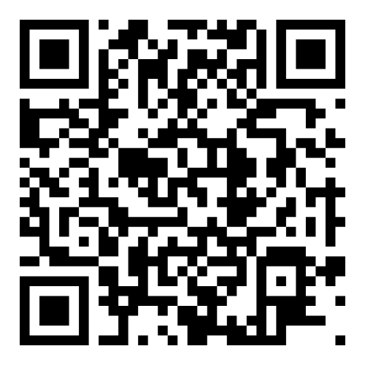
Join us on WhatsApp for updates and resources.

Slide 15
Thank you

